Slide 1

FINAL DEFENCEPRESENTATION ON :
Digital Watermarking using LSB and DWT
Team Members
Aman Mool (740303)
Rabin Phaiju (740329)
Rodip Duwal (740334)
Roshan Dumaru (740335)
Under Supervision of:
Er. Bikash Chawal

Slide 2
Content
1
Introduction
2
Objective
3
Statement of Problem
4
Scope
5
Literature Review
6
Methodology
7
Result & Discussion
8
References
9

Slide 3
Introduction
A technique by which we embed copyright mark into digital content
Used to identify the original creator and owner of digital media.
Prominently used for tracing copyright infringements.
2 types
Visible Digital Watermarking
Invisible Digital Watermarking

Slide 4
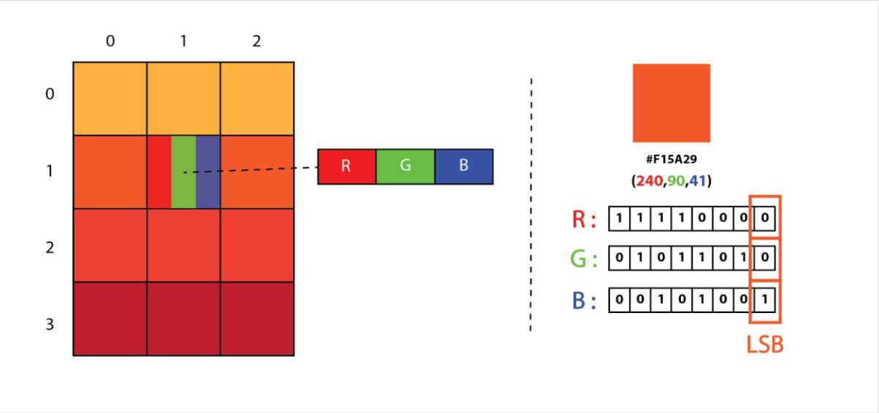
Introduction
LSB steganography, a technique in which messages are hidden inside an image by replacing each pixel least significant bits with the bits of the message to be hidden.
Fig 1 Representation of image as a 2D Array of RGB pixels

Slide 5
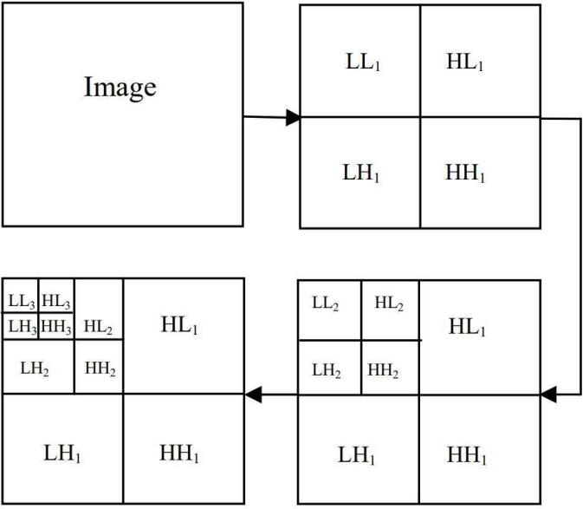
Introduction
A discrete wavelet transform (DWT) is a transform that decomposes a given signal into a number of sets, where each set is a time series of coefficients describing the time evolution of the signal in the corresponding frequency band.
Fig 2: 3-Level discrete wavelet decomposition

Slide 6
Introduction
Noise
Gaussian noise, a kind of signal noise that has a probability density function (pdf) equal to that of the normal distribution (which is also known as the Gaussian distribution).
Salt-and-pepper noise, also known as impulse noise, is a form of noise sometimes seen on digital images.

Slide 7
Introduction
Test Method
Mean squared error (MSE) measures the amount of error in statistical models. It assesses the average squared difference between the observed and predicted values.
Peak signal-to-noise ratio (PSNR) is the ratio between the maximum possible power of an image and the power of corrupting noise that affects the quality of its representation.

Slide 8
Objective
To embed and extract watermark from image visibly and invisibly and analysis of scaling factor while using the alpha blending.

Slide 9
Statement of Problem
Issues such as Counterfeiting, forgery, fraud, and pirating

Slide 10
Scope
Protecting intellectual property rights of owner.

Slide 11
Literature Review
"LSB Image Steganography," by D. Jain purposed a technique in which messages are hidden inside an image by replacing each pixel’s least significant bit.
"Image Watermarking Using 3-Level Discrete Image Watermarking ," by G. R. S. Nikita Kashyap proposed a technique for implementing a robust image watermarking technique for the copyright protection based on 3 level DWT.

Slide 12
Methodology

Slide 13
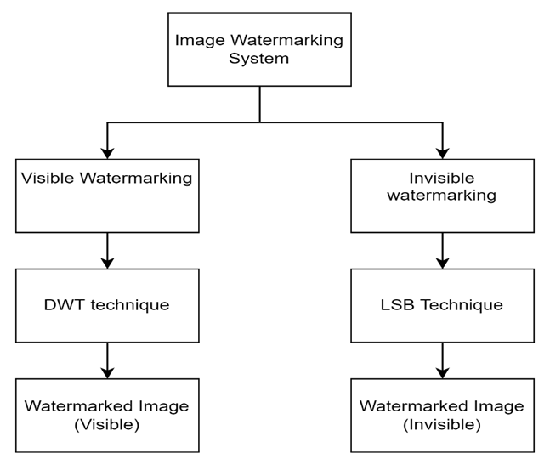
Methodology
Fig 3 : Block Diagram of Image Watermarking System

Slide 14
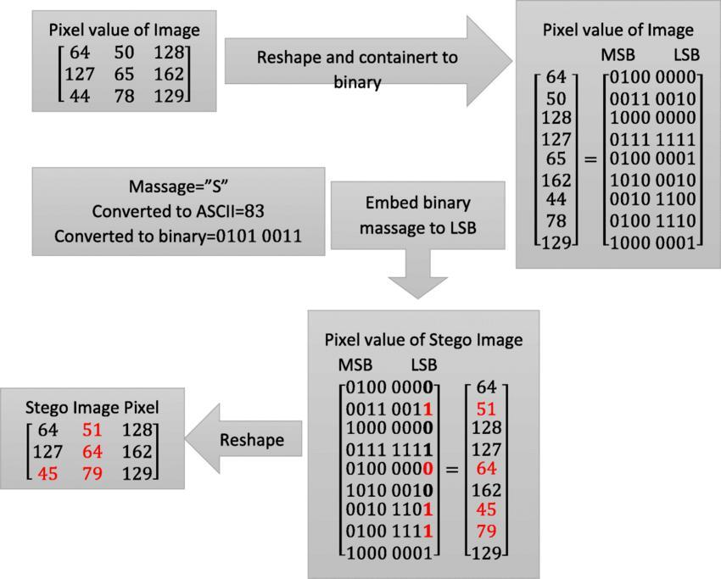
Fig 4 : Working of LSB

Slide 15
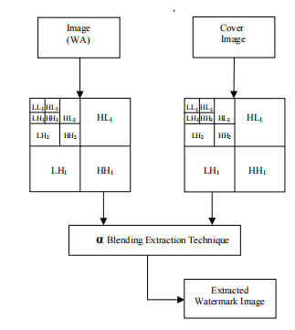
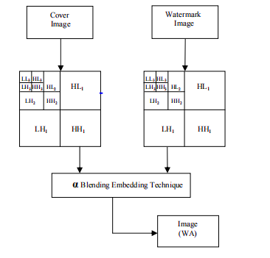
Fig 5 : Embedding & Extraction of Digital Image Watermarking using DWT

Slide 16
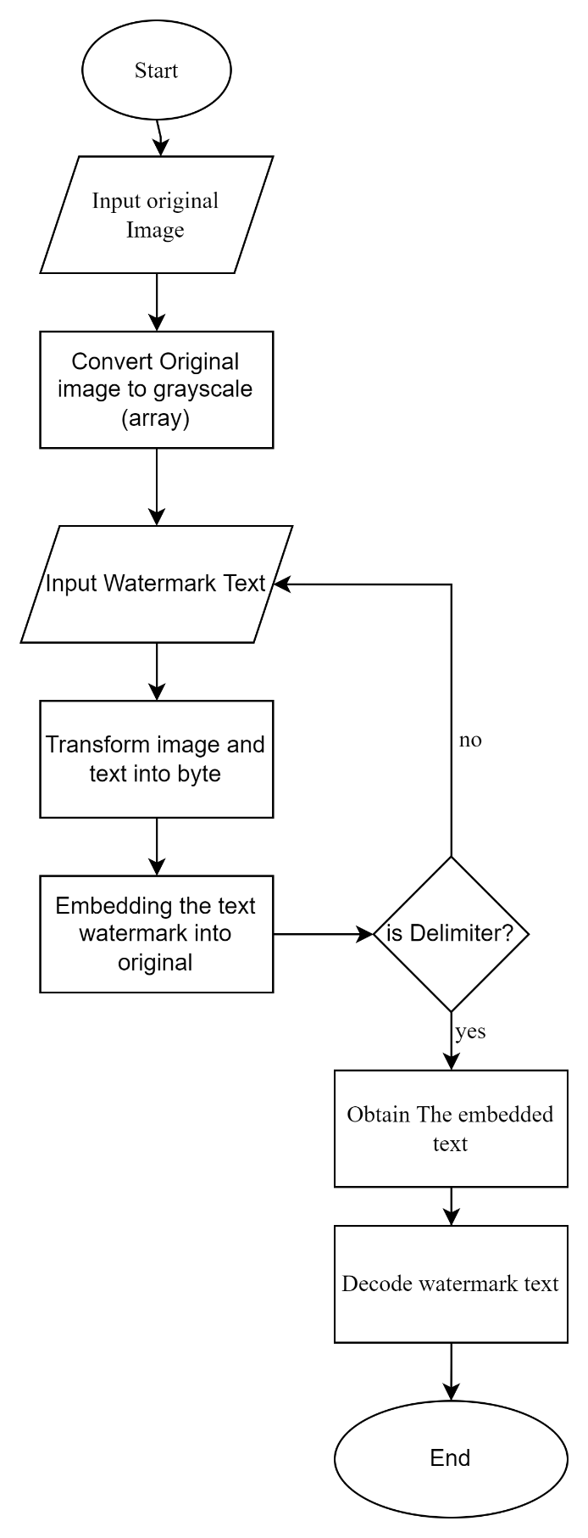
Fig 6 :Flow chart of Digital Image Watermarking

Slide 17
Result & Discussion

Slide 18
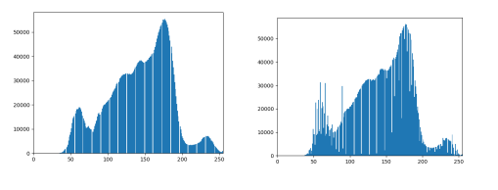
Overview
we embedded the text as well as the image using 1-DWT using HAAR method and the histogram of resulting and original image & watermarked image is as below:
Fig 7 : Original Image
Fig 8 : Watermarked Image

Slide 19


LSB (Invisible Watermarking)
Fig 9 : Original & Watermarked image using LSB

Slide 20


DWT (Visible Watermarking)
Fig 10 : Original & Watermark image

Slide 21


Fig 11 : Watermarked Image & Decoded Watermarked

Slide 22


DWT (Visible Watermarking)
Fig 12 : Original & Watermark image

Slide 23


Fig 13 : Watermarked Image & Decoded Watermarked

Slide 24
References
[1] M. a. S. V. Narang, "Digital watermarking using discrete wavelet transform.," International Journal of Computer Applications, 2013.
[2] S. P. Ingale, "Digital Watermarking Algorithm using DWT Technique," International Journal of Computer Science and Mobile Computing, vol. V, no. 5, pp. 01-09, 2017.
[3] G. R. S. Nikita Kashyap, "Image Watermarking Using 3-Level Discrete Image Watermarking Using 3-Level Discrete," I.J.Modern Education and Computer Science, Bhilai, 2012.
[4] D. Jain, "LSB Image Steganography," 23 7 2020.

Slide 25
THANK YOU

